Slide 1

Global Teleconsultation Portal (GTP)
Responding to a Consult

Slide 2
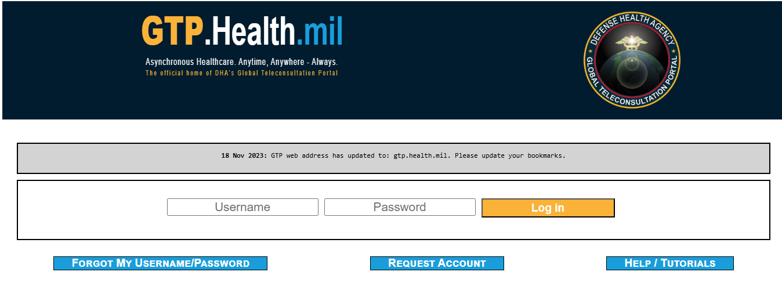
Responding to a GTP Consultation Procedure
PREFACE
GTP (Global Teleconsultation Platform) is designed to be a worldwide-accessible, HIPAA-compliant, secure, web-based system for health care personnel (IDC, RN, NP, PA, Physicians) allowing them access to medical specialists from the PATH/GTP System. The area of coverage includes EUCOM, CENTCOM, and AFRICOM and their regionally associated Fleet, Army, Air Force and Marine assets.
HOW TO PLACE A CONSULT REQUEST IN GTP
Start by going to the login page : GTP (v5.0) - Login (health.mil)
If you don’t already have an account, request an account by clicking Request an Account.
For further guidance on requesting an account refer to slides 10-12

Slide 3
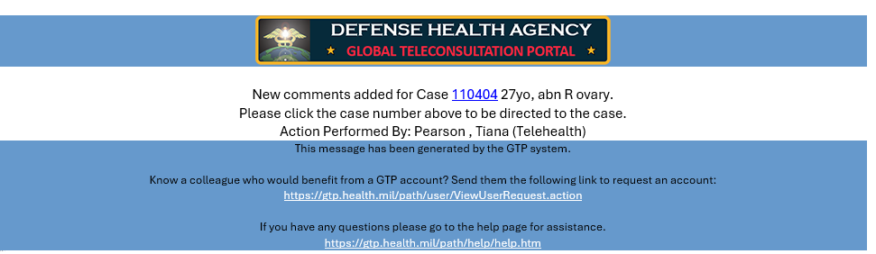
Responding to a GTP Case
GTP notification-received via email
Respond to the originating medical personnel within 1 business day
Select the case number and it will direct you to the case
Click on case #

Slide 4
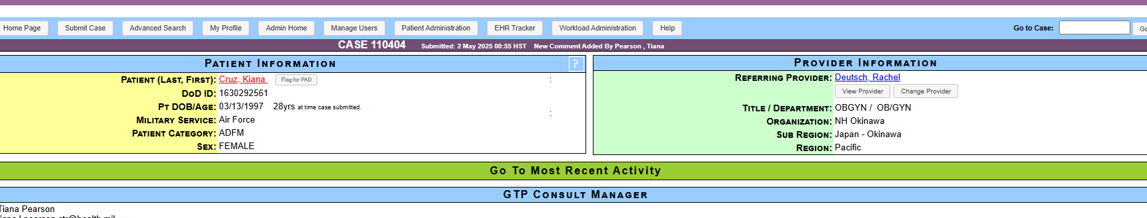
Responding to a GTP Case
After clicking on the case # from the email, the selected case will open in your browser

Slide 5
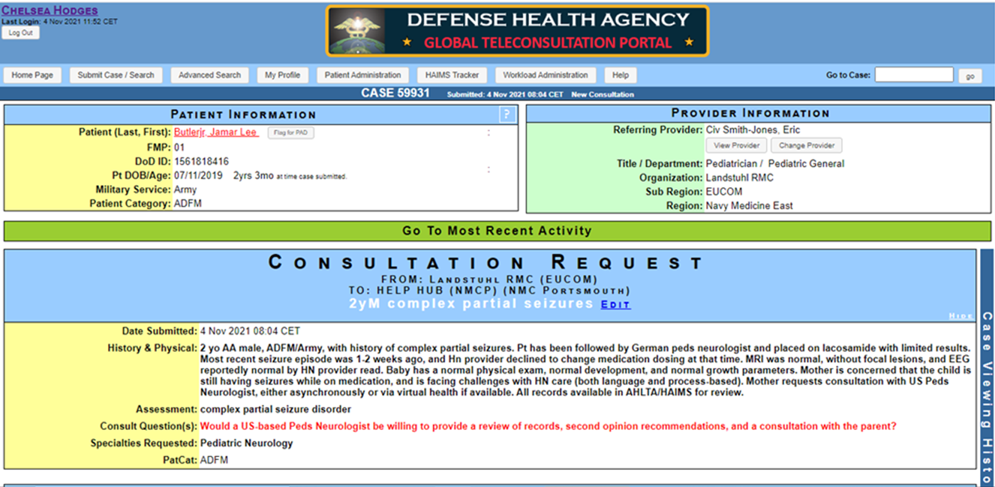
Responding to a GTP Case
Once logged in, the responder sees the screen below

Slide 6
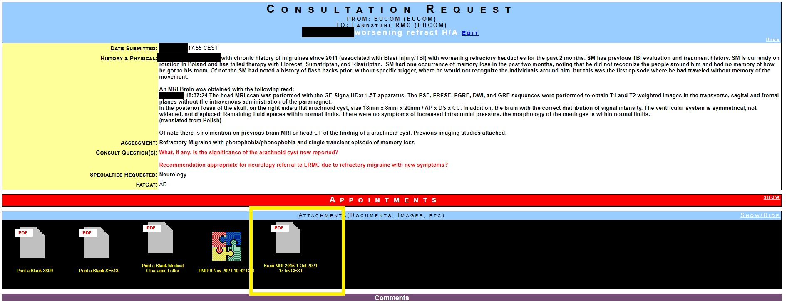
Responding to a GTP Case
Click on “Attachments” to view (documents, images) for the case
Validate patient history with MHS GENESIS

Slide 7
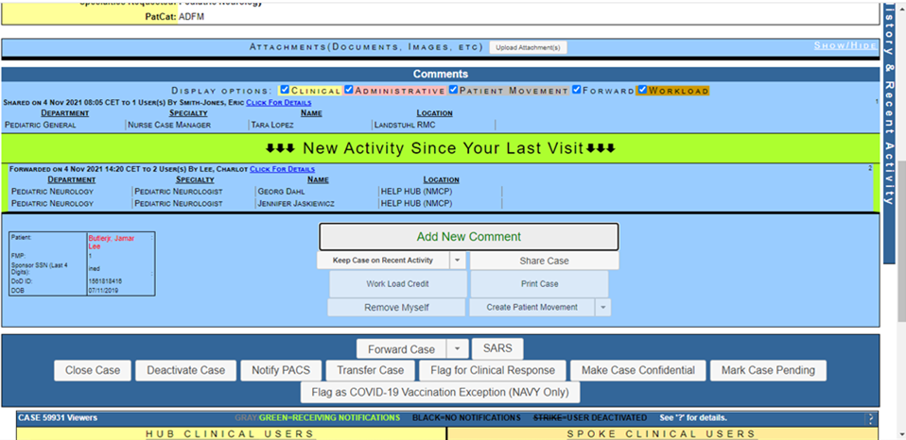
Responding to a GTP Case
Click on “Add New Comment” to respond to the case

Slide 8
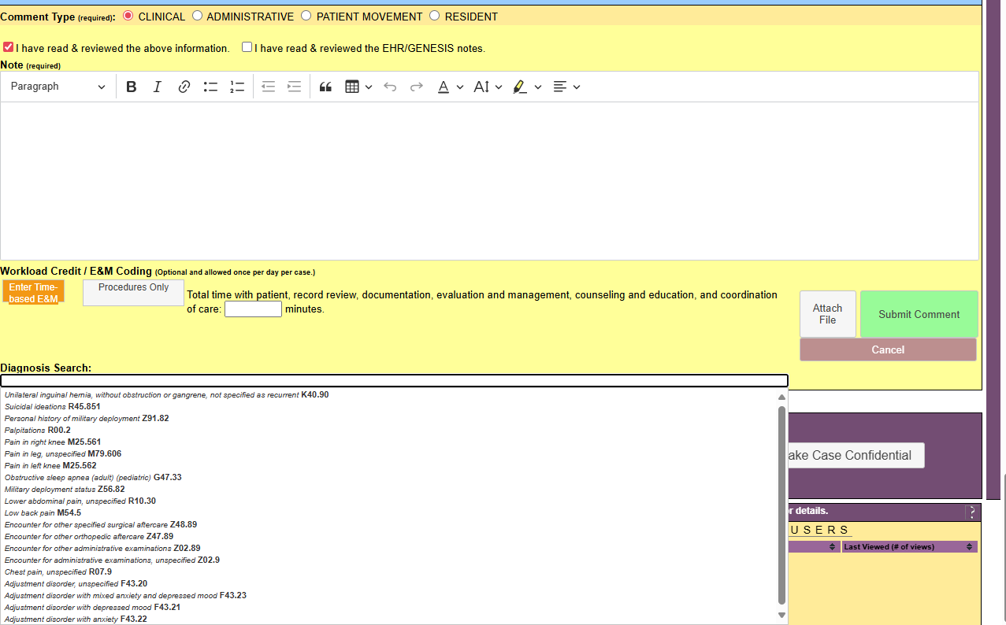
Responding to a GTP Case
Enter your response/recommendation
Click on comment type CLINICAL
Click on “I have read and reviewed the above information” AND “I have read & reviewed the EHR/GENESIS notes”
Click on proper workload credit/E&M Coding based on diagnosis and the time spent answering the consult
Click “Submit Comment”

Slide 9
Documenting and Coding for a GTP Case
*Steps to capture and receive credit for answering a GTP consult:
The workload shall be captured with the appropriate time-based E+M codes and CPT codes
Enter the amount of time spent reviewing the consultation, reviewing the EHR, and providing medical advice.
For any procedures, please enter the appropriate CPT code.
*If you are at a MTF where the coding department does not know how to code GTP encounters, please submit a ticket to GSC: https://gsc.health.mil

Slide 10
GTP Account and Access
Click on: GTP (v5.0) - Login (health.mil) to get to the home screen on the GTP site
Click Request an Account

Slide 11
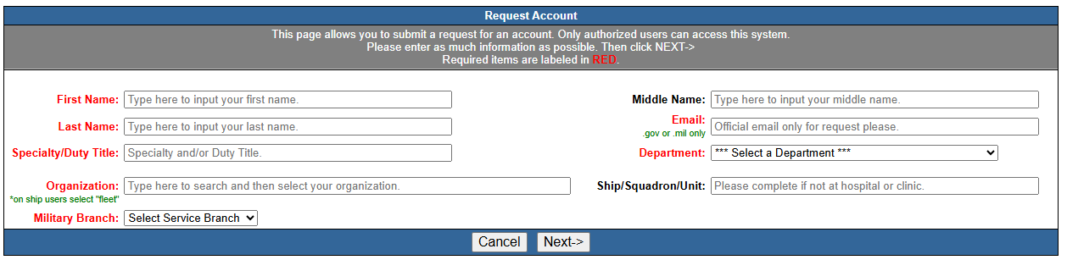
Requesting a GTP Account
MUST fill in all required fields, then click next

Slide 12
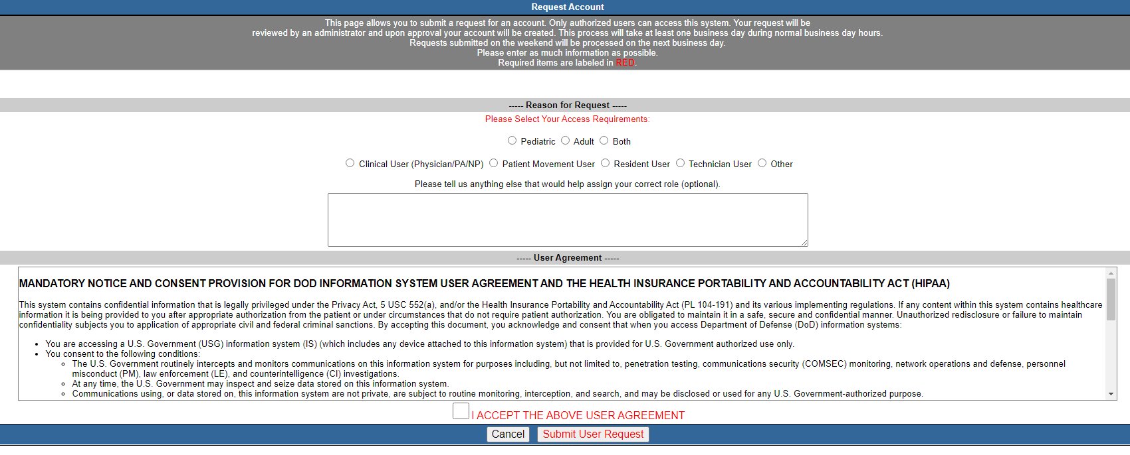
Requesting a GTP Account
Fill in required fields
Click “I accept the above user agreement” box
Select “Submit User Request” tab
Once submitted the request will be reviewed and approved by an administrator within 24-72 hours

Slide 13
Training POCs
COL. Charles T. Nguyen – GTP Medical Director
Mr. Steven Parks – GTP Government Lead Program
Manager Mr. Richard Mcclelland– GTP Atlantic Program Manager
Mrs. Ryshena Eversley – Indo-Pacific Program Manager
Mr. Aaron Pines– GTP Pacific Program Manager
GTP HELP DESK
https://gsc.health.mil 1-800-600-9332

